Slide 1
Global Warming Hypotheses and Results
Assignment 6: Data-based Arguments
Arnav Dashaputra
Stance: Global Warming is not real
Note: I do think that global warming is real personally, I just found it easier to defend using the data given.

Slide 2
Hypothesis 1: Average temperatures in industrialized cities have been the same since 1995, than before 1995.
The null hypothesis to disprove my theory is as follows; since 2000, there has been a general over-industrialization and population growth trend. Especially in first-world countries like America and parts of Europe. To prove that global warming is an issue, there would need to be higher average temperatures as time continued. To test this, I took average temperatures from 2 different cities in 1960, and then in the same cities in years close to 1995. I then tested this hypothesis using p-values to confirm it. The cities I used are: Beijing China, and Lindenberg Germany. I compared each of these cities’ average temperatures from 1960, and then 1995 for Lindenberg and 2001 for Beijing.

Slide 3
Hypothesis 1: Results
First I will look at my results for Lindenberg. I ended with a standard deviation of 2.903º C, with a z-score of 0.172 units and a p-value of 0.432. This p value is much larger than the generally used value of 0.05, or 5%. Even using Bonferroni correction, at least 9 additional corrects (tests performed) would be needed to have a p value that would fit at or under 0.05. This p value indicates that the given evidence is not statistically significant enough to support the null hypothesis. Next, for Beijing, I ended up with a standard deviation of 4.32º C, with a z-score of 1.012 units and a p-value of 0.156. Even this p value is larger than 0.05, though less than Lindenbergs. At Least 3-4 tests would be needed to have this value in an acceptable range to support my hypothesis. \
Therefore, either the null hypothesis is incorrect, or these specific data samples are not enough to support it. This gives proof to my hypothesis, as it shows that the slight increase in average temperatures are more of a random chance/coincidence, than having reasoning behind it.

Slide 4
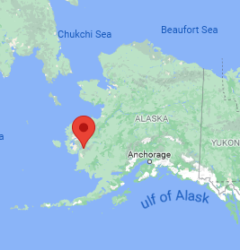
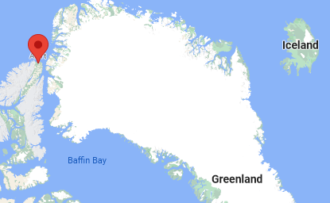
Hypothesis 2: Average temperatures in northern areas of the world have not changed at all
Despite talk of the ice caps melting, rising sea levels, and a resulting loss of land area, I believe that in northern areas of the world, average temperature readings have remained the same. To prove this, I will compare the average temperatures of northern-bound towns in 1960, and then in 2000. The null hypothesis would be that the temperatures have changed, either higher or lower (but most would argue against this saying it would be higher, without a chance of randomness being the cause).
The cities of Bethel, Alaska, and Alert, Canada, shown respectively.

Slide 5
Hypothesis 2: Results
First I will look at my results for Alert. I ended with a standard deviation of 5.778º C, with a z-score of -0.03 units and a p-value of 0.511. This p value is much larger than the generally used value of 0.05, or 5%. This p value indicates that the given evidence is not statistically significant enough to support the null hypothesis. Next, for Bethel, I ended up with a standard deviation of 3.74º C, with a z-score of 0.612 units and a p-value of 0.27. Even this p value is larger than 0.05, though less than Alert.
Therefore, this is the same exact conclusion to my previous hypothesis: either the null hypothesis is incorrect, or these specific data samples are not enough to support it. This gives proof to my hypothesis, as it shows that the slight increase in average temperatures are more of a random chance/coincidence, than having reasoning behind it.

